Slide 1
Grant Public Utility District
J.P. MORGAN PUBLIC FINANCE TRANSPORTATION & UTILITY INVESTOR FORUM
Bonnie Overfield
Chief Financial Officer
March 2022

Slide 2
Disclaimer
This investor presentation is provided as of March 2022 by Public Utility District No. 2 of Grant County, Washington (the “District”). Financial data and other information provided herein are not warranted as to completeness or accuracy and are subject to change without notice.
This Investor Presentation is provided for your information and convenience only. This Investor Presentation does not constitute an offer to sell or the solicitation of an offer to buy any security or other financial instrument or to adopt any investment strategy. Any offer or solicitation with respect to any outstanding or future issuance of bonds will be made solely by means of a Preliminary Official Statement or Official Statement, which describes the actual terms of such bonds. In no event shall the District be liable for any use by any party of, for any decision made or action taken by any party in reliance upon, or for any inaccuracies or errors in, or omissions from, the information contained herein and such information may not be relied upon by you in evaluating the merits of participating in any transaction mentioned herein. Nothing in these materials constitutes a commitment by the District to enter into any transaction. No assurance can be given that any transaction mentioned herein could in fact be executed.
Any investment decision regarding any outstanding or future issuance of bonds should only be made after a careful review of the complete Official Statement. You will be responsible for consulting with your own advisors and making your own independent investigation and appraisal of the risks, benefits, appropriateness and suitability of any transactions contemplated by this presentation and neither the District nor any other party is making any recommendation (personal or otherwise) or giving any investment advice and will have no liability with respect thereto. Transactions involving any outstanding or future issuance of bonds may not be suitable for all investors. You should consult with your own advisors as to the suitability of any outstanding or future issuance of bonds for your particular circumstances.
Past performance is not indicative of future returns, which will vary. This presentation may contain “forward‐looking” statements that involve risks, uncertainties and assumptions. If the risks or uncertainties ever materialize or the assumptions prove incorrect, the results may differ materially from those expressed or implied by such forward‐looking statements. We caution you not to place undue reliance on these statements. All statements other than the statements of historical fact could be deemed forward‐looking. All opinions, estimates, projections, forecasts and valuations are preliminary, indicative and are subject to change without notice.

Slide 3
Who is Grant PUD?
Founded in 1938, municipal corporation by state statute (Title 54 RCW - public utility districts)
Vertically integrated utility with generation Priest Rapids Project System aka “PRP” and distribution Electric System
Operates generation of over 2,100 MW of clean, carbon free energy
Owner/operator of PRP (two dam system- Priest Rapids Development and Wanapum Development)
In county additional small hydro generation and long-term resource contracts
Other sources of energy via wholesale market (Mid-C)
County provider of retail electricity and wholesale fiber for over a 2,777 square mile service area
Net seller into wholesale market, management of balancing area and transmission system
Local control by state statute, 5 person elected commission
PRP is one of the lowest cost generation systems in the country resulting in very low delivered retail rates
Diversified retail load with strong experienced growth
Notes:
Confirmed with Public Affairs that this is still correct. 3/14/mg

Slide 4
Generation
1955-FERC license issued to construct PRP
Both dams were generating power by 1963 (Priest Rapids Development first power generation in 1959, Wanapum first power generation in 1963).
At the time the final unit was installed, PRP was the largest non-fed project
Long-term power sales contracts for separate developments with 8 northwest utilities thru 2005/2009
2005 & 2009– new offtake contracts went into effect – combined output of Priest Rapids and Wanapum developments with 26 purchasers
2008-FERC awarded new 44-year license to operate PRP (2052 license expiry)
2013- Grant PUD celebrates the completion of its Advanced Turbine Replacement Project at Wanapum Dam . The project included the replacement of all 10 of the dam’s original turbines.
2016- Priest Rapids Dam turbine and generator rewind work begins
2020 - In October, the final rehabbed generating unit at Wanapum Dam went online. This marked the completion of a 20-year project to modernize all of the dam’s 10 turbines and generators.
2022- Priest Rapids Dam - 4 units will be completed as of June 2022, final unit expected to be completed in November 2029 (each unit approximately is 14 months)
Historical cost of production
Year | $/MWH | % Avg Water | MHW Gen
2021 | $20.00 | 87% | 9,056,940
2020 | $18.02 | 104% | 9,463,889
2019 | $20.68 | 84% | 8,277,762
2018 | $18.13 | 113% | 9,258,927
Notes:
2022 PR bullet per 3/22 email from Vince Von Paul;

Slide 5
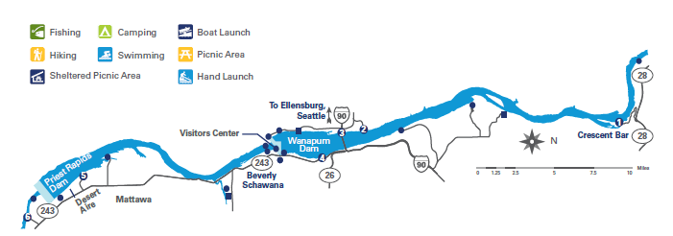
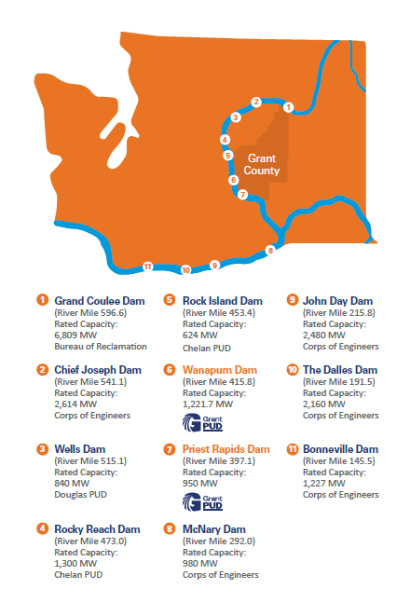
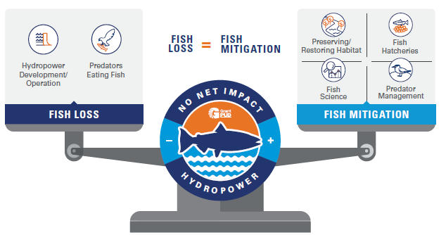
Generation - PRP
Recreation and natural resource requirements accompany the stewardship of PRP
One of the region’s greatest contributors to the enhancement and protection of native fish/habitat
*Per 2020 Annual Report
Notes:
Graphics from 2020 Annual Report, 2021 not complete.

Slide 6
Generation - PRP
The long-term contracts define output rights and percentage share of production costs on an annual basis.
Grant’s output rights are to claim physical power to meet load on a critical water planning basis up to 63.3% of output.
Grant’s retail load met this level in 2014
12.5% of output contractually goes to long term purchasers
2.5% Exchangers, 10.0% Conversion Contracts
Historically purchasers received a larger share of output as Grant’s load was growing
30% of output via a contractual financial mechanism allows Grant to meet load on a critical water planning basis.
Total physical and financial rights to PRP project are expected to be exhausted in 2024. Retail customers’ loads won’t surpass expected project capabilities until after 2030.
The District utilizes the wholesale market for meeting load combined with other resources
2021 PRP Project Cost Allocation
Grant PUD | 87.49%
PacifiCorp | 2.66%
Portland General | 2.66%
Puget Sound Energy | 1.54%
Avista | 1.17%
Tacoma Power | 0.65%
Seattle City Light | 0.63%
Cowlitz PUD | 0.37%
EWEB | 0.32%
Exchangers (9 small shares) | 2.51%
 | 100%
Notes:
Cost Allocation Updated with PRP Percentage doc from accounting. PRP remaining availability load growth based on FPA commission presentation (10-06-21).

Slide 7
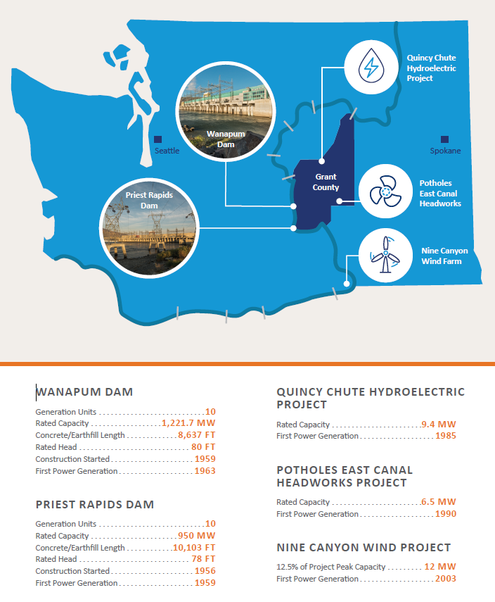
Generation & Other Power Sources
Two in-county small hydro generation projects operated by the District with rights to output, contracts with the Columbia Hydro Power Authority (owner), expiry in 2025 and 2030
Nine-Canyon Wind Farm output contract managed by Energy Northwest, expiry in 2030
Bonneville PF contract for small Grand Coulee area load (~5 aMW), expiry in 2028
District manages wholesale program through long-term and short-term market contracts to meet retail load and to manage wholesale position
Notes:
Per 2021 Annual Report

Slide 8
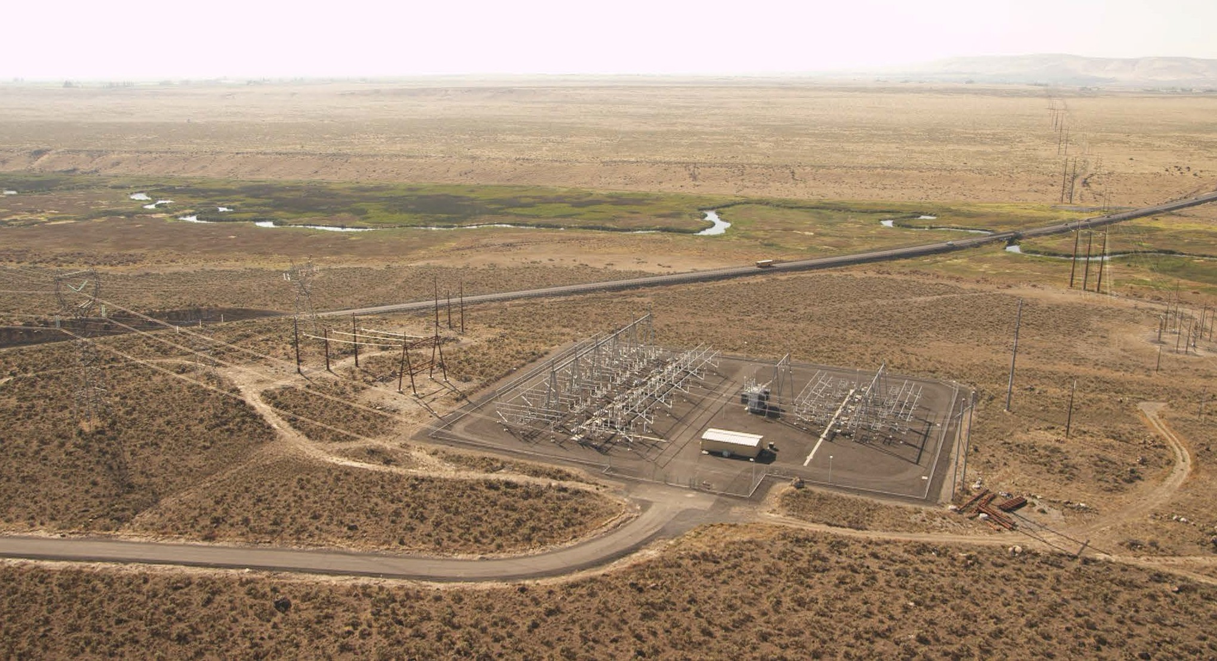
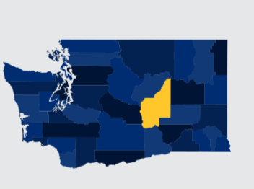
Electric System
Electric System meets the load of retail customers and manages power supply
Consolidated Revenue 2021
(in $ millions)
Electric System comprised of sophisticated single- and three-phase electric service
District maintains a large service area with ~3,900 miles of distribution lines and ~500 miles of transmission lines
Retail Electric Revenues is the largest revenue category
Wholesale fiber operations is included in Electric System with an increasing “take rate” of ~67%
Notes:
Revenue from Q4 Financial Forecast Ex B.

Slide 9
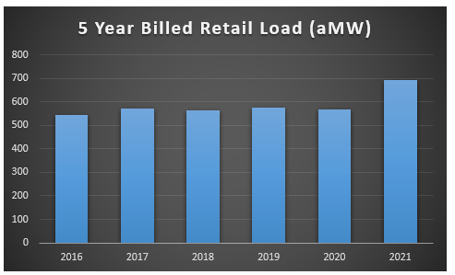
Electric System – Retail
Growing overall system retail load, net 47% increase in past 10 years and 27% in the past 5 years
System is dual peaking with winter and summer peaks
Residential and irrigation rate base has been stable with a large demonstrated growth experienced in the commercial/industrial sector
Customer driven growth includes upfront payments from customers for a connection fee
System capital investment in distribution and transmission infrastructure enabling additional future growth
Notes:
5 Yr Billed Retail Load for 2019-2021 pulled from revenue & kwh recon (kwh delivered/1000/8760).

Slide 10
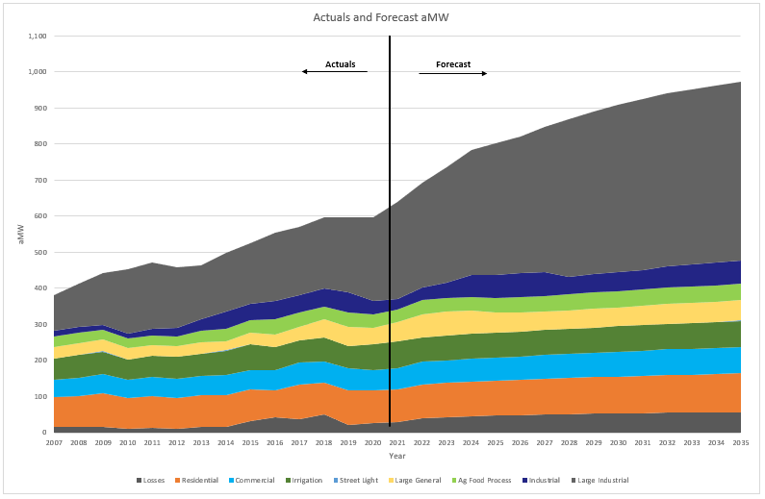
Electric System – Retail (cont.)

Slide 11
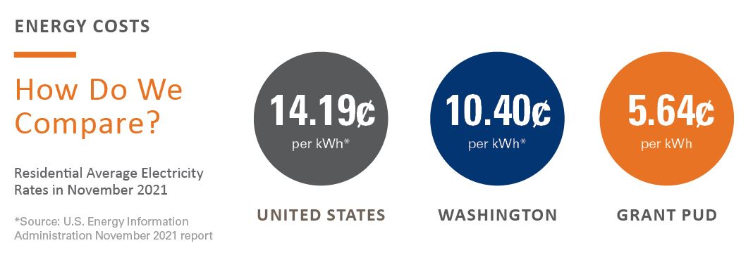
Electric System - Retail
Low retail delivered rates, resulting from PRP favorable generation economics combined with wholesale management/strategy
2021 System Average Rate of 3.8 cents / KWH delivered
Rate policies provide protection to core retail customer classes and allocate marginal costs associated with growth/risks to non-core customers
Commission-adopted price strategy of annual small/predictable increases, targeted at 2% or less since 2014
Commission has statutory rate making authority; managed based on financial metrics

Slide 12
Electric System - Retail
Electric System retail meters = 53,213
Customer count = 52,915
AMI smart meter installation was completed at the end of 2019
Service territory is over ~90% electric heating
Grant is the only electric service provider in the county
Notes:
From Report of Billing (11/1/21-11/30/21)

Slide 13
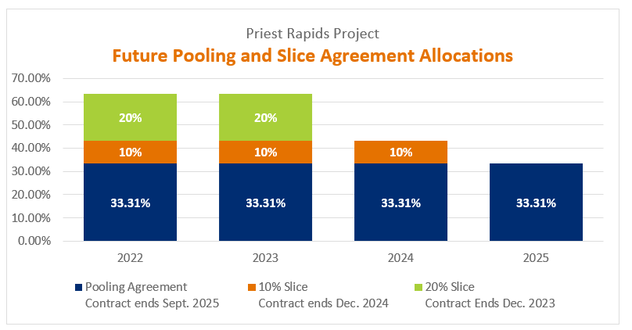
Electric System Power Supply and Wholesale Market
District has implemented a hedging strategy over time that mitigates inherent fuel (water supply) risks and market costs
“Slice” contracts have been a historical operational component of PRP with long term and shorter-term purchasers
Electric System sells “slice” output
contracts from 63.3% physical offtake
of PRP
District receives firm revenue stream
and can purchase load positions in
netted contracts
Market purchases and sales are
utilized as needed to manage smaller
positions

Slide 14
Financial Results
District has demonstrated strong financial results with robust planning parameters
Debt Service Coverage target ≥ 1.8x
Bond Covenants are 1.25x Electric Sr Lien, 1.15x PRP Sr Lien and 1.10x Electric Jr Lien
2021 Net Income = $75.0 million
2021 Days Cash On Hand = 338 days consolidated ($460 million)
Targeted Debt to Net Plant Ratio of ≤60%
2021 Total Utility Plant (book value) $2.3 billion
District maintains strong credit ratings
Moody’s Aa3 both systems
Fitch AA both systems
S&P AA PRP / AA+ Electric System
*PRELIMINARY 2021 data
Two Year Quarterly Liquidity Position
Notes:
Data from the 3-8-22 Quarterly Staff Reports

Slide 15
Financing Plan (cont.)
Capital is financed through a mix of available revenues and debt
Five-year capital plan:
PRP = $294 million
Electric = $448 million
Estimated 30% of five-year plan to be funded with debt (subject to change)
Notes:
Pulled data from page 6 of the commission packet.

Slide 16
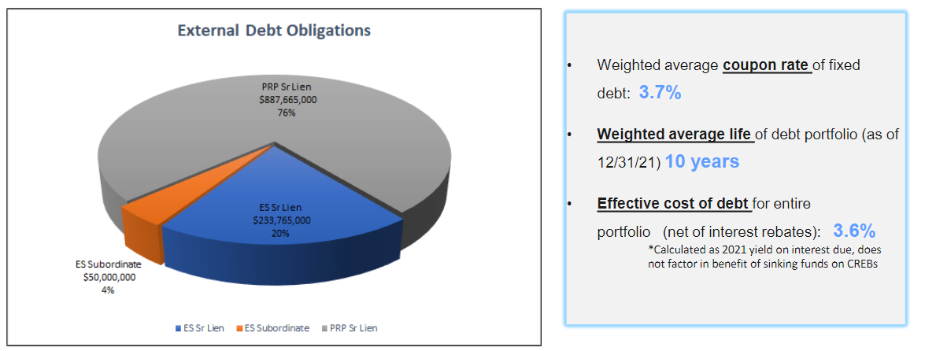
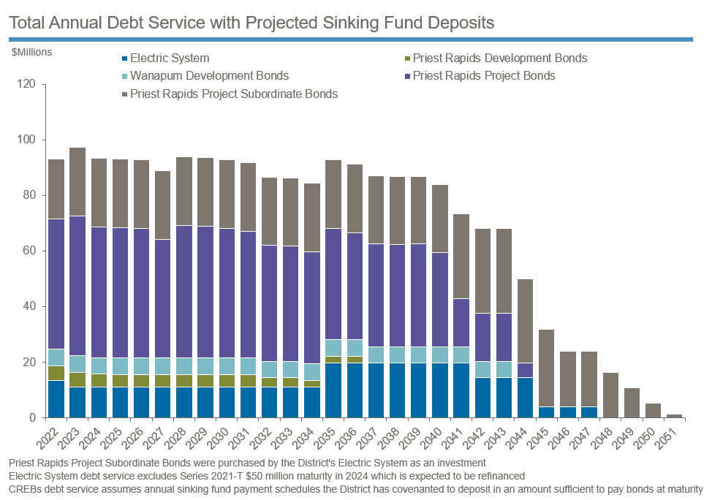
Financing -Existing Debt
The District issues taxable and tax-exempt debt and utilizes both fixed-rate debt and variable rate instruments
Notes:
Data from staff reports in the 3-8-22 Quarterly Staff Reports (Debt & Treasury)

Slide 17
COVID-19 Impacts
March, 2020 - Closed public facilities to prevent the spread of COVID-19 as a pandemic was declared by health officials.
Established an Incident Management Team, priorities included
Protecting employee health
Plan operations at varying Incident Criticality Levels (ICLs)
Safely and reliably deliver essential services without interruption
Proactive mitigation efforts for operational and financial impacts:
Closing lobbies and recreation sites
Requiring employees not required to be on-site for essential services to work from home
“Social distancing” and personal protective equipment measures for on-site staff
Contact tracing
COVID-19 preventative testing and a vaccine planning committee established
June, 2020 – Recreation sites re-opened
February, 2022 – Customer Service offices re-opened
The effects of the pandemic did not result in any interruptions to service for customers or material adverse financial impacts.

Slide 18
Notes:
https://www.youtube.com/watch?v=Iex5Kr8rgFA

Slide 19
Thank You!
Additional investor information available on District “Bond Holders and Potential Investors” page:
http://www.grantpud.org/your-pud/who-we-are/bond-holders-and-potential-investors-page
Provides easy access to Official Statements for all outstanding bonds
Annual reports
Rating agency reports
Notice of Sale Documents (when applicable)
Investor presentations (when applicable)
This presentation can be accessed at the above website
Munite Information Hub
https://go.munite.com/#/retail/gcpud/obligor/26059/0
For future investor relations questions please contact:
Bonnie Overfield, Chief Financial Officer
509-754-5088

